Slide 1
Mappings
Lecture 12

Slide 2
OBJECTIVE Using conformal mappings
OUTCOME
Will be able to construct conformal mappings between many kinds of domain

Slide 3
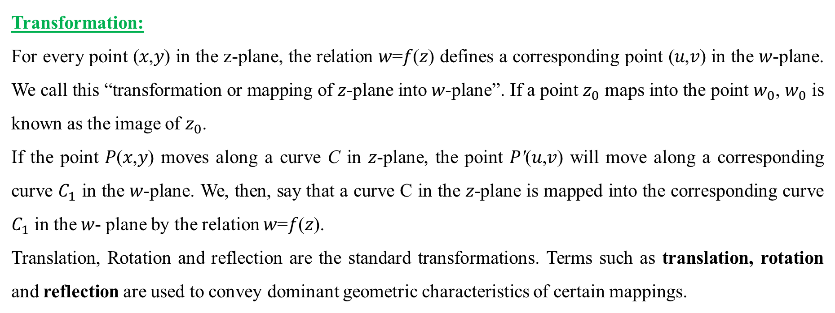
Geometrical Representation:
To draw curve of complex variable (𝑥,𝑦)we take two axes i.e., one real axis and the other imaginary axis. Several points (𝑥,𝑦) are plotted on 𝑧-plane, by taking different value of 𝑧 (different value of x and y). The curve C is drawn by joining the plotted points. The diagram obtained is called Argand diagram.
Transformation:
For every point (𝑥,𝑦) in the z-plane, the relation 𝑤=𝑓(𝑧) defines a corresponding point (𝑢,𝑣) in the 𝑤-plane. We call this “transformation or mapping of 𝑧-plane into 𝑤-plane”. If a point $z_{0}$ maps into the point $w_{0}$, $w_{0}$ is known as the image of $z_{0}$.
If the point 𝑃(𝑥,𝑦) moves along a curve C in 𝑧-plane, the point 𝑃′(𝑢,𝑣) will move along a corresponding curve $C_{1}$ in the 𝑤-plane. We, then, say that a curve C in the 𝑧-plane is mapped into the corresponding curve $C_{1}$ in the 𝑤- plane by the relation 𝑤=𝑓(𝑧).
Translation, Rotation and reflection are the standard transformations. Terms such as translation, rotation and reflection are used to convey dominant geometric characteristics of certain mappings.

Slide 4
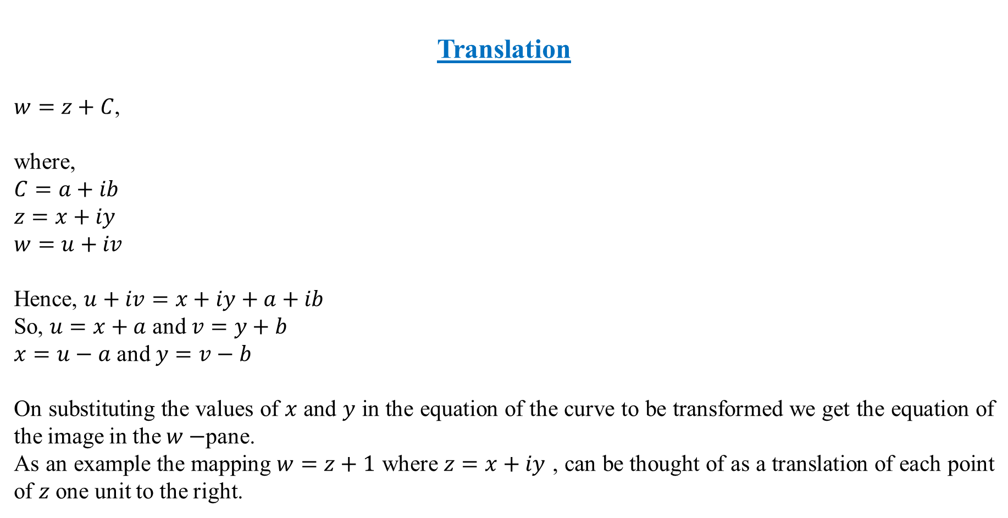
Translation
$w=z+C$,
where,
$$C=a+ib$$
$$z=x+iy$$
$$w=u+iv$$
Hence, $u+iv=x+iy+a+ib$
So, $u=x+a$ and $v=y+b$
$x=u−a$ and $y=v−b$
On substituting the values of 𝑥 and 𝑦 in the equation of the curve to be transformed we get the equation of the image in the $w−$pane.
As an example the mapping $w=z+1$ where $z=x+iy$ , can be thought of as a translation of each point of $z$ one unit to the right.

Slide 5
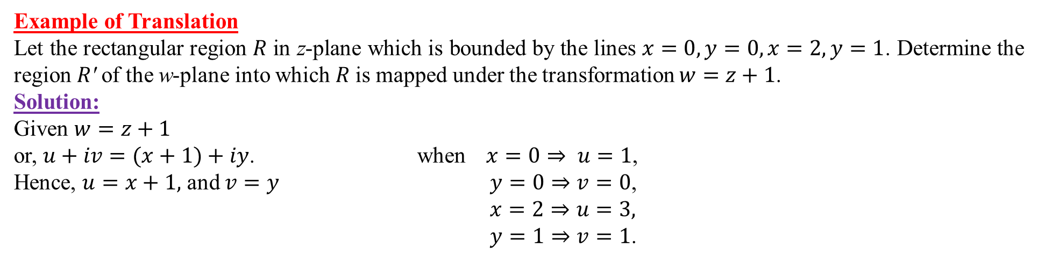
Example of Translation
Let the rectangular region 𝑅 in z-plane which is bounded by the lines $x=0,y=0,x=2,y=1$. Determine the region 𝑅′ of the w-plane into which 𝑅 is mapped under the transformation $w=z+1$.
Solution:
Given $w=z+1$
or, $u+iv=(x+1)+iy$. when $x=0⇒ u=1$,
Hence, $u=x+1,$ and $v=y$ $y=0⇒v=0$,
$x=2⇒u=3,$
$y=1⇒v=1$.

Slide 6
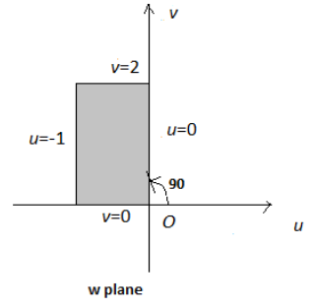
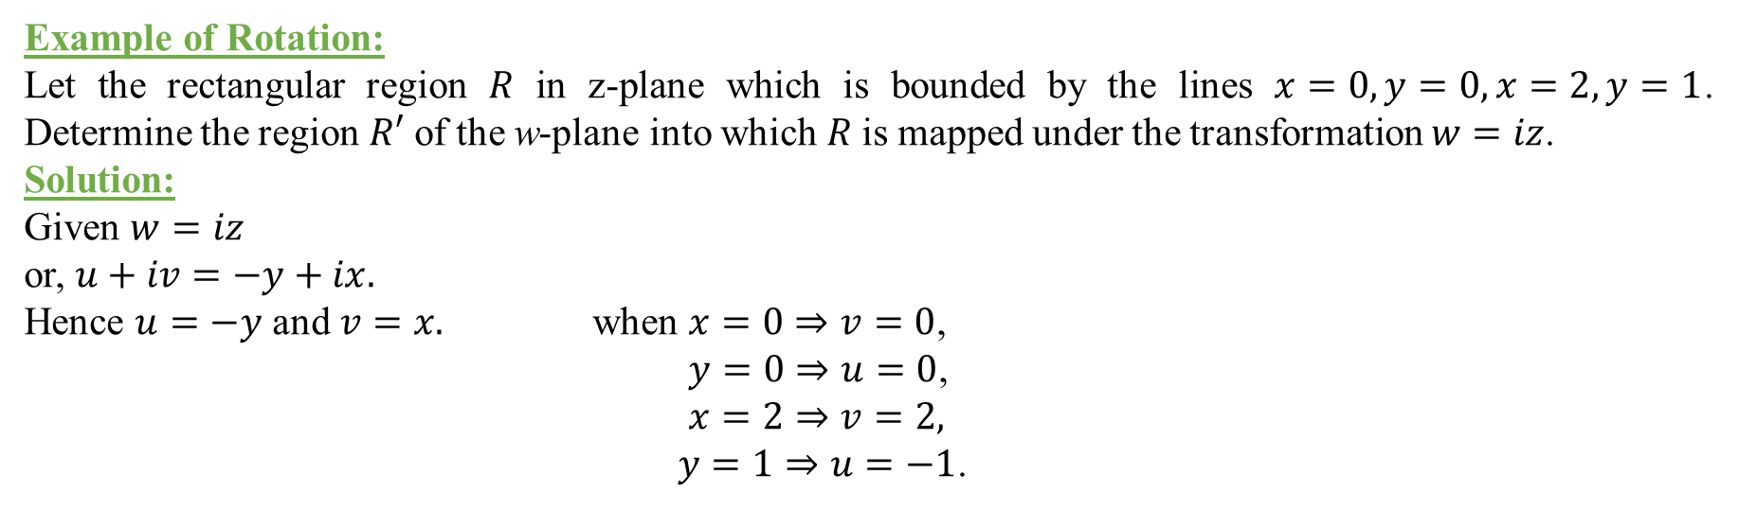
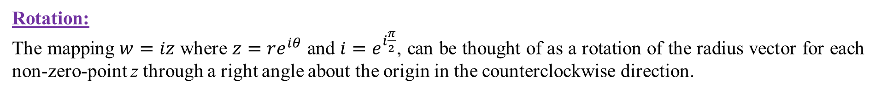
Rotation:
The mapping $w=iz$ where $z=re^{iθ}$ and $i=e^{i\frac{π}{2}}$, can be thought of as a rotation of the radius vector for each non-zero-point z through a right angle about the origin in the counterclockwise direction.
Example of Rotation:
Let the rectangular region 𝑅 in z-plane which is bounded by the lines $x=0,y=0,x=2,y=1$. Determine the region $R′$ of the w-plane into which 𝑅 is mapped under the transformation $w=iz$.
Solution:
Given $w=iz$
or, $u+iv=−y+ix.$
Hence $u=−y$ and $v=x.$ when $x=0⇒v=0$,
$y=0⇒u=0$,
$x=2⇒v=2,$
$y=1⇒u=−1$.

Slide 7
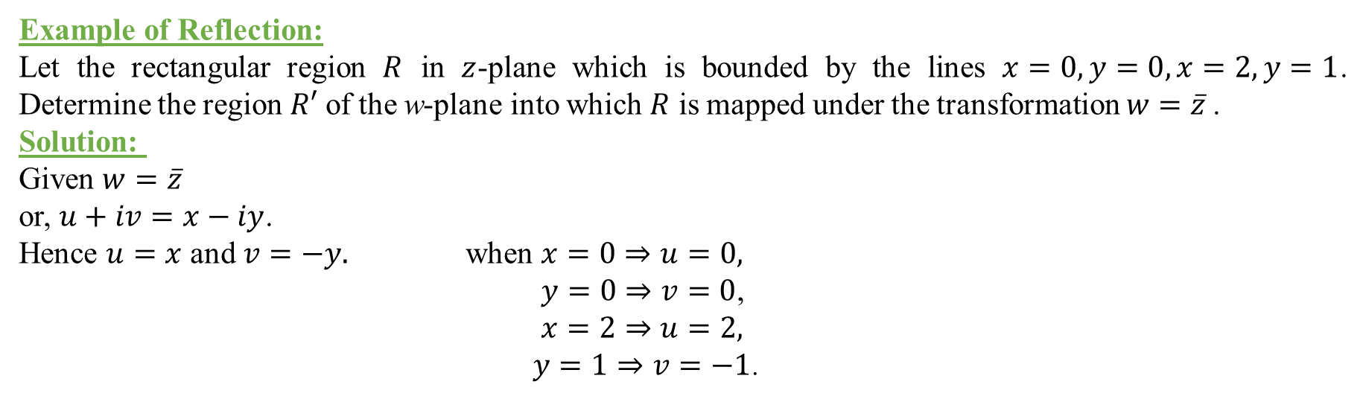
Reflection:
The mapping $w=\overline{z}$transforms each point of $z=x+iy$into its reflection in the real axis.
Example of Reflection:
Let the rectangular region $R$ in $z$-plane which is bounded by the lines $x=0,y=0,x=2,y=1$. Determine the region $R′$ of the w-plane into which $R$ is mapped under the transformation $w=\overline{z}$.
Solution:
Given $w=\overline{z}$
or, $u+iv=x−iy$.
Hence $u=x$ and $v=−y.$ when $x=0⇒u=0,$
$y=0⇒v=0$,
$x=2⇒u=2,$
$y=1⇒v=−1$.

Slide 8
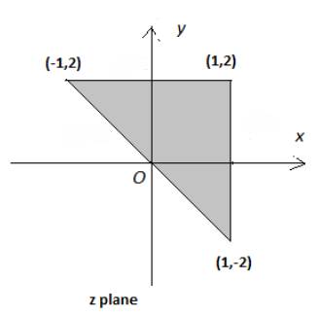
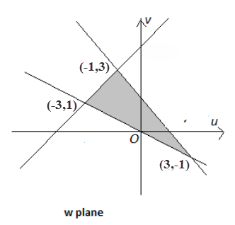
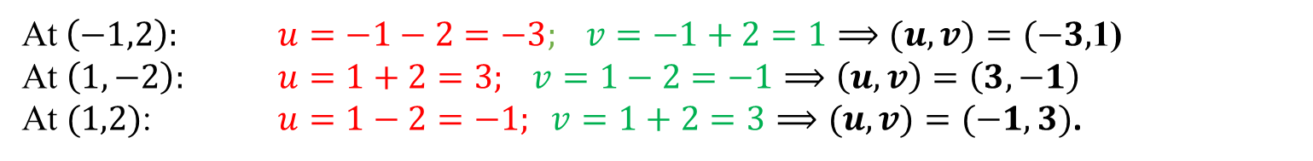
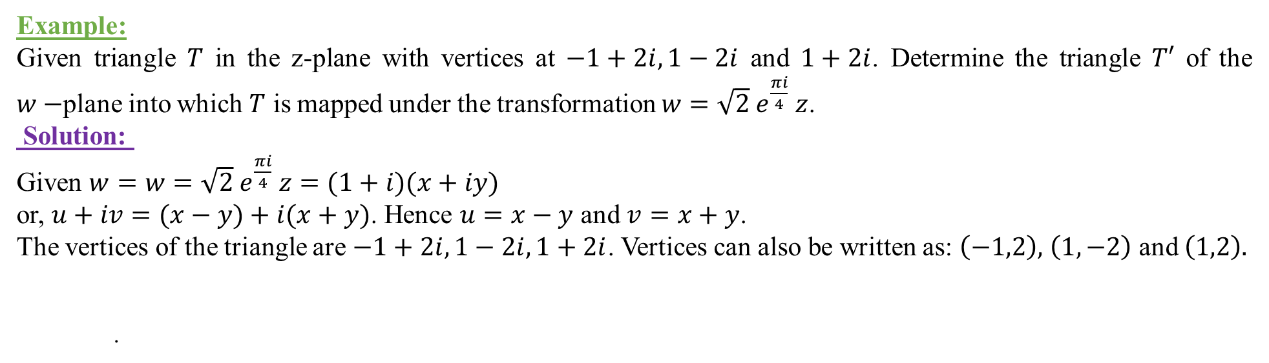
Example:
Given triangle $T$ in the z-plane with vertices at $−1+2i,1−2i$ and $1+2i$. Determine the triangle $T′$ of the $w−$plane into which $T$ is mapped under the transformation $w=\sqrt{2} e^{\frac{πi}{4}} z$.
Solution:
Given $w=w=\sqrt{2} e^{\frac{πi}{4}} z=(1+i)(x+iy)$
or, $u+iv=(x−y)+i(x+y)$. Hence $u=x−y$ and $v=x+y$.
The vertices of the triangle are $−1+2i,1−2i,1+2i$. Vertices can also be written as: $\left(−1,2\right),$ $\left(1,−2\right)$ and $\left(1,2\right).$
.
At$\left(−1,2\right):$ $u=−1−2=−3; v=−1+2=1⟹(u,v)=(−3,$1)
At $\left(1,−2\right):$ $u=1+2=3; v=1−2=−1⟹\left(u,v\right)=\left(3,−1\right)$
At $(1,2)$: $u=1−2=−1; v=1+2=3⟹(u,v)=(−1,3)$.

Slide 9
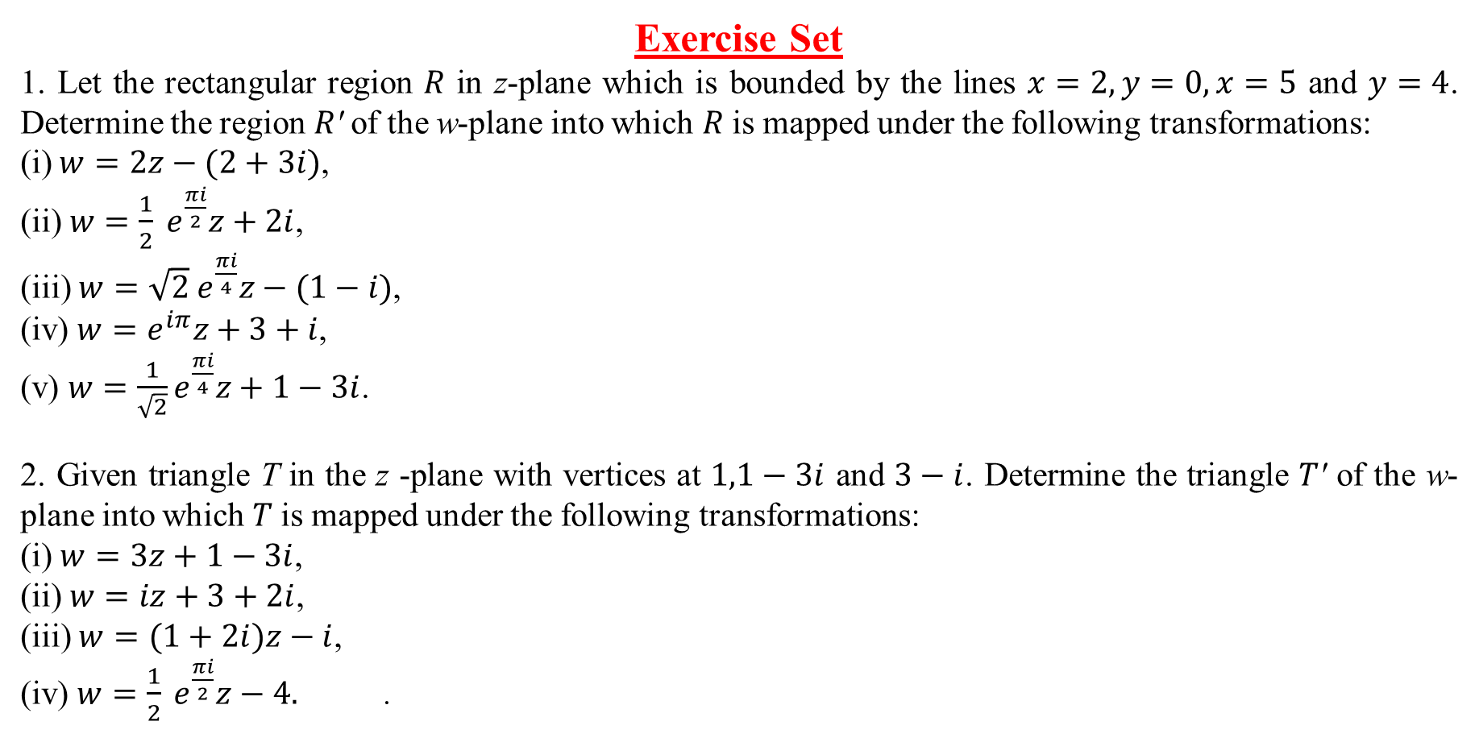
Exercise Set
1. Let the rectangular region 𝑅 in z-plane which is bounded by the lines $x=2,y=0,x=5$ and $y=4$. Determine the region 𝑅′ of the w-plane into which 𝑅 is mapped under the following transformations:
(i) $w=2z−(2+3i)$,
(ii) $w=\frac{1}{2} e^{\frac{πi}{2}}z+2i$,
(iii) $w=\sqrt{2} e^{\frac{πi}{4}}z−(1−i)$,
(iv) $w=e^{iπ}z+3+i$,
(v) $w=\frac{1}{\sqrt{2}}e^{\frac{πi}{4}}z+1−3i$.
2. Given triangle T in the z -plane with vertices at $1,1−3i$ and $3−i$. Determine the triangle 𝑇′ of the w-plane into which 𝑇 is mapped under the following transformations:
(i) $w=3z+1−3i$,
(ii) $w=iz+3+2i$,
(iii) $w=(1+2i)z−i$,
(iv) $w=\frac{1}{2} e^{\frac{πi}{2}}z−4.$ .

Slide 10
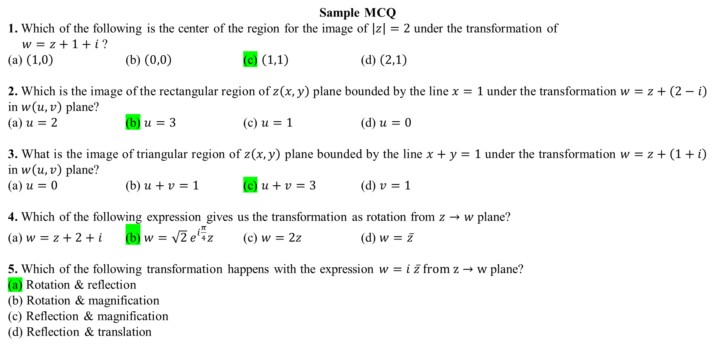
Sample MCQ
1. Which of the following is the center of the region for the image of $\left|z\right|=2$ under the transformation of
$w=z+1+i$ ?
(a) $\left(1,0\right)$ (b) $\left(0,0\right)$ (c) $\left(1,1\right)$ (d) $\left(2,1\right)$
2. Which is the image of the rectangular region of $z\left(x,y\right)$ plane bounded by the line $x=1$ under the transformation $w=z+\left(2−i\right)$ in $w\left(u,v\right)$ plane?
(a) $u=2$ (b) $u=3$ (c) $u=1$ (d) $u=0$
3. What is the image of triangular region of $z\left(x,y\right)$ plane bounded by the line $x+y=1$ under the transformation $w=z+\left(1+i\right)$ in $w\left(u,v\right)$ plane?
(a) $u=0$ (b) $u+v=1$ (c) $u+v=3$ (d) $v=1$
4. Which of the following expression gives us the transformation as rotation from $z→w$ plane?
(a) $w=z+2+i$ (b) $w=\sqrt{2} e^{i\frac{π}{4}}z$ (c) $w=2z$ (d) $w=\overline{z}$
5. Which of the following transformation happens with the expression $w=i \overline{z} from z→w$ plane?
(a) Rotation & reflection
(b) Rotation & magnification
(c) Reflection & magnification
(d) Reflection & translation

